Slide 1
Integrated species distribution models
1 May 2023

Slide 2
Outline
Lightning intro to SDMs & data for SDMs
Data integration and iSDMs
How integration works
Advantages
Challenges & opportunities
Coding demos
Q&A

Slide 3
“A statistical model that relates species observations to environmental characteristics”

Slide 4
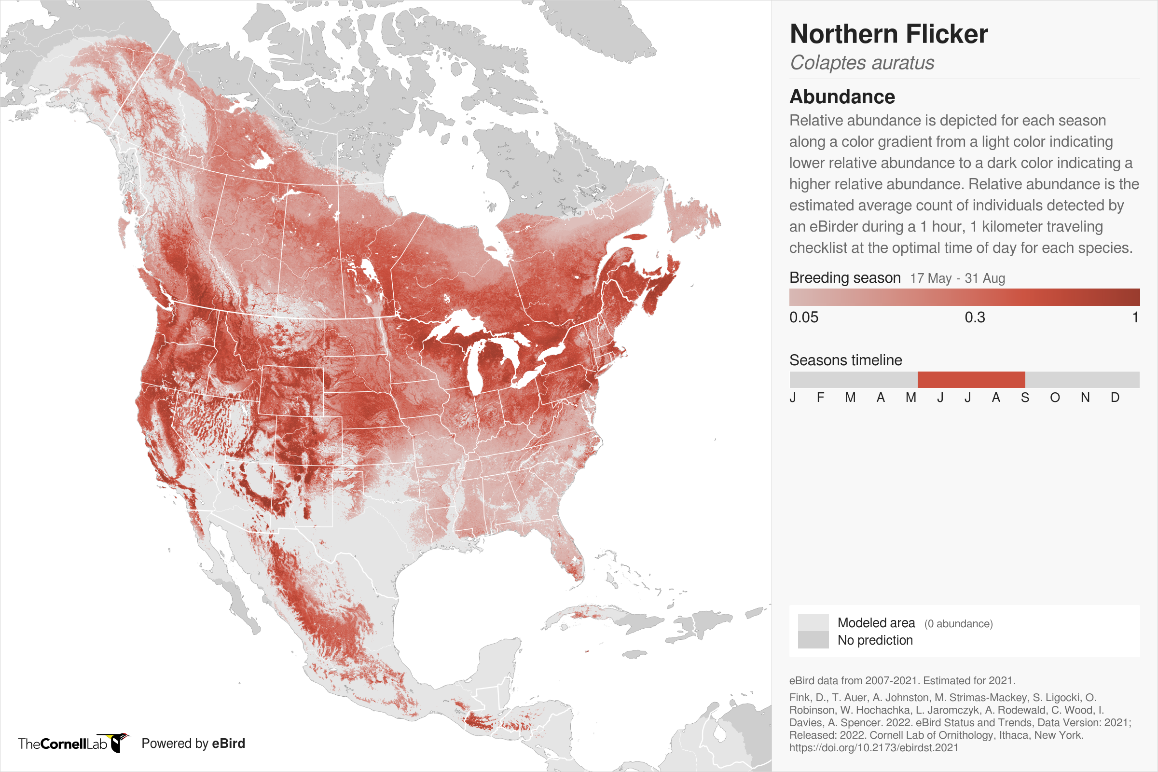

Slide 5

SDM – a broad category
occupancy models
MaxEnt
N-mixture models
GLMs
Distance sampling

Slide 6
Types of data

Slide 7
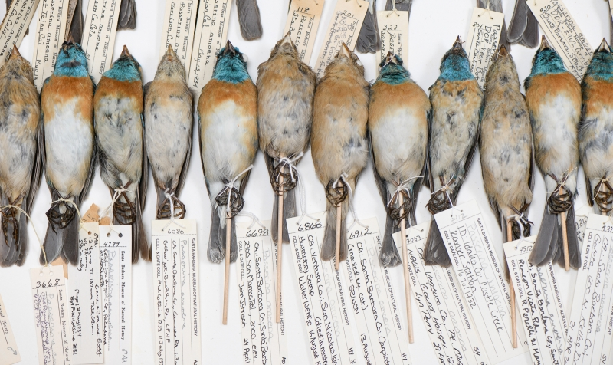
Santa Barbara Museum of Natural History https://tinyurl.com/5n823u4c

Slide 8
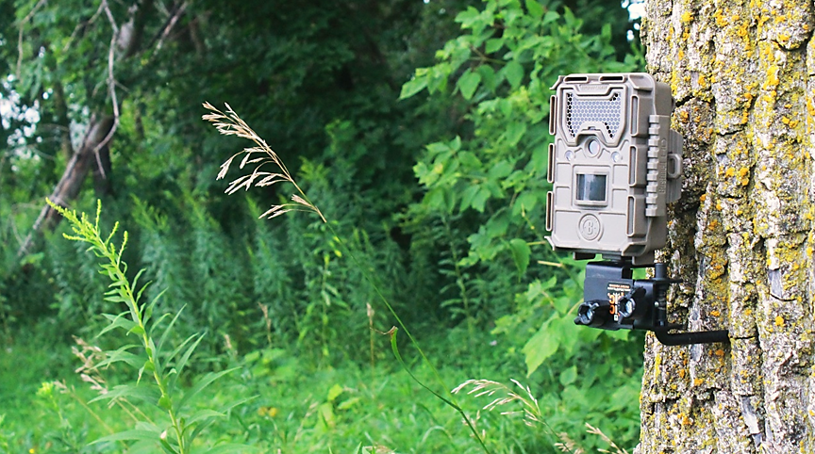

Slide 9
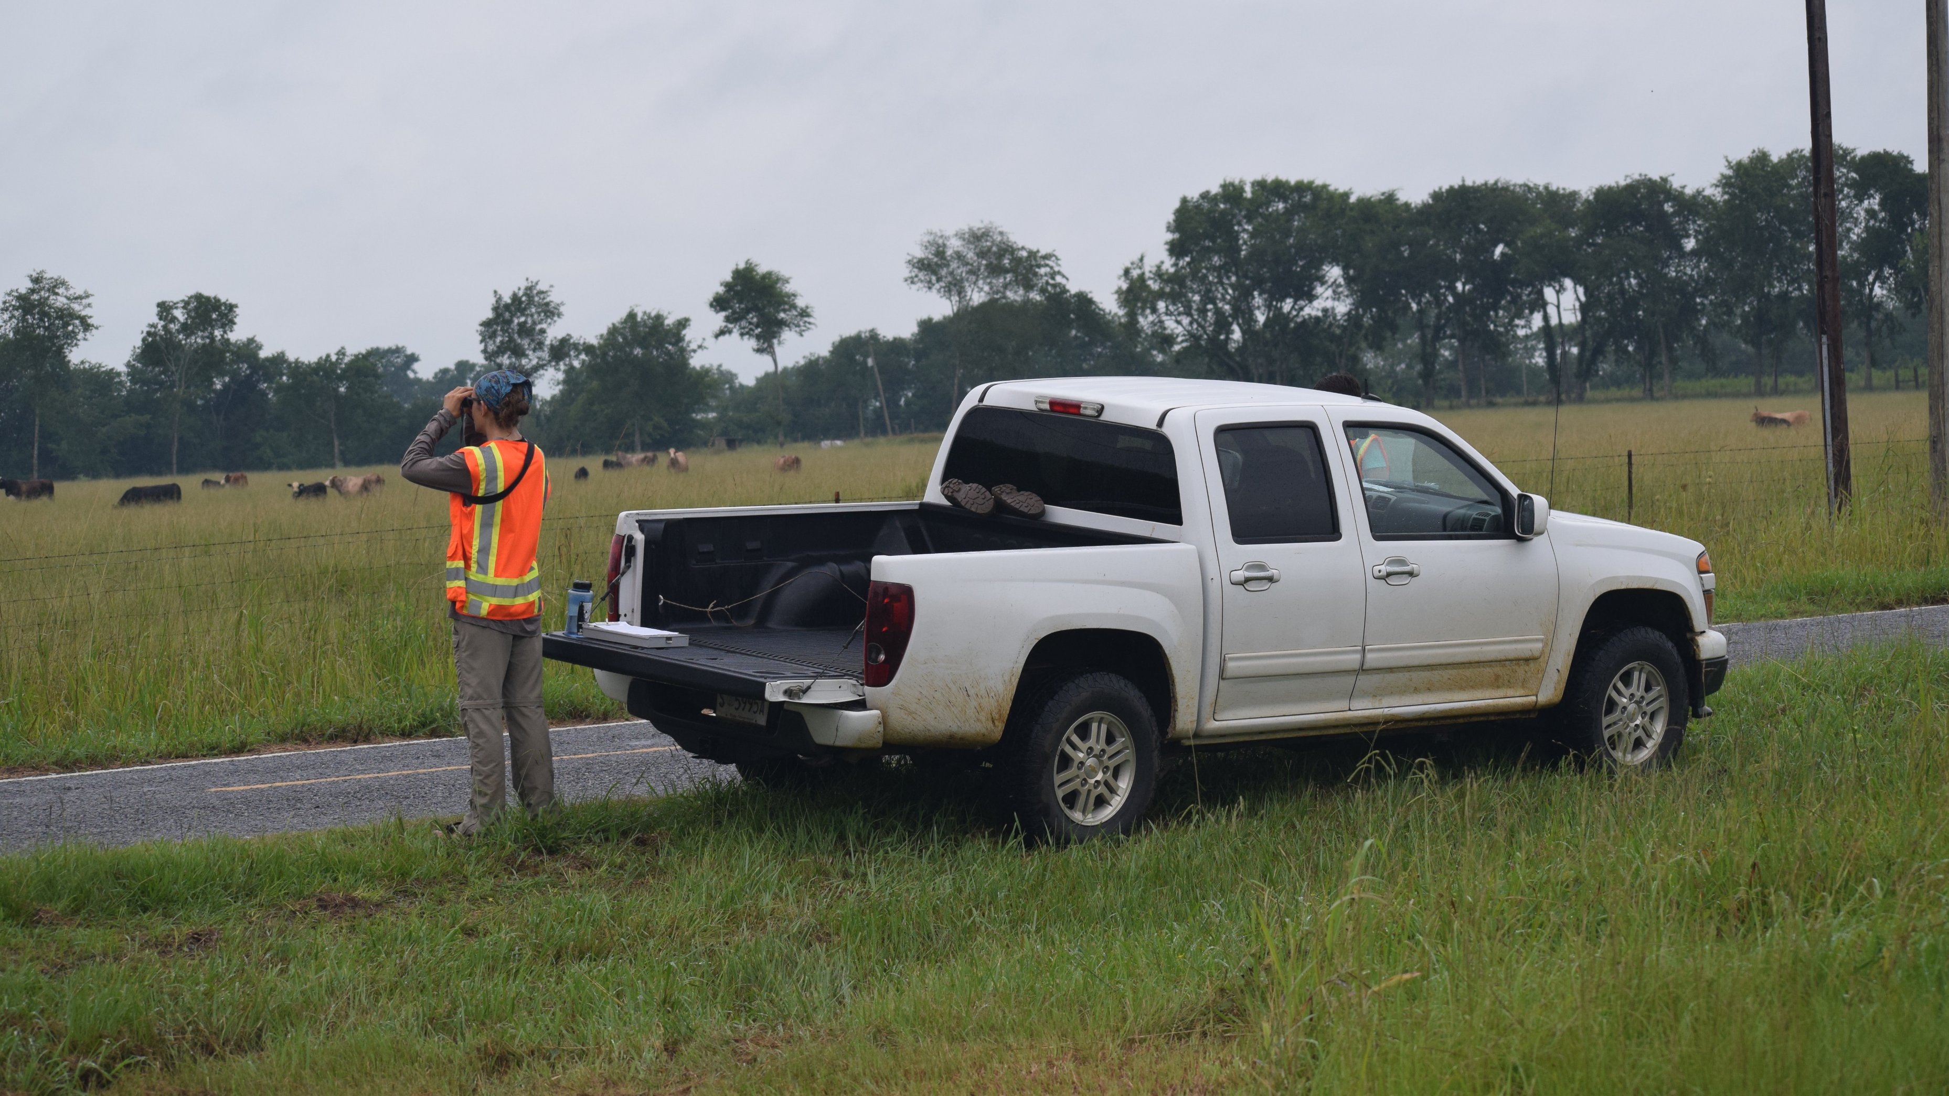

Slide 10
Dealing with imperfect detection
Option 1: repeated visits
 | Visit 1 | Visit 2 | Visit 3
Site 1 | 1 | 0 | 1
Site 2 | 0 | 0 | 1
Site 3 | 0 | 1 | 1

Slide 11
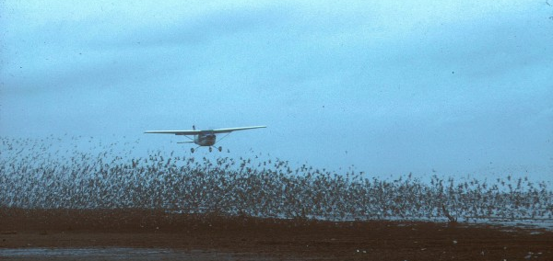
Dealing with imperfect detection
Option 2: distance sampling
Detection probability
Distance to animal

Slide 12
Data integration

Slide 13
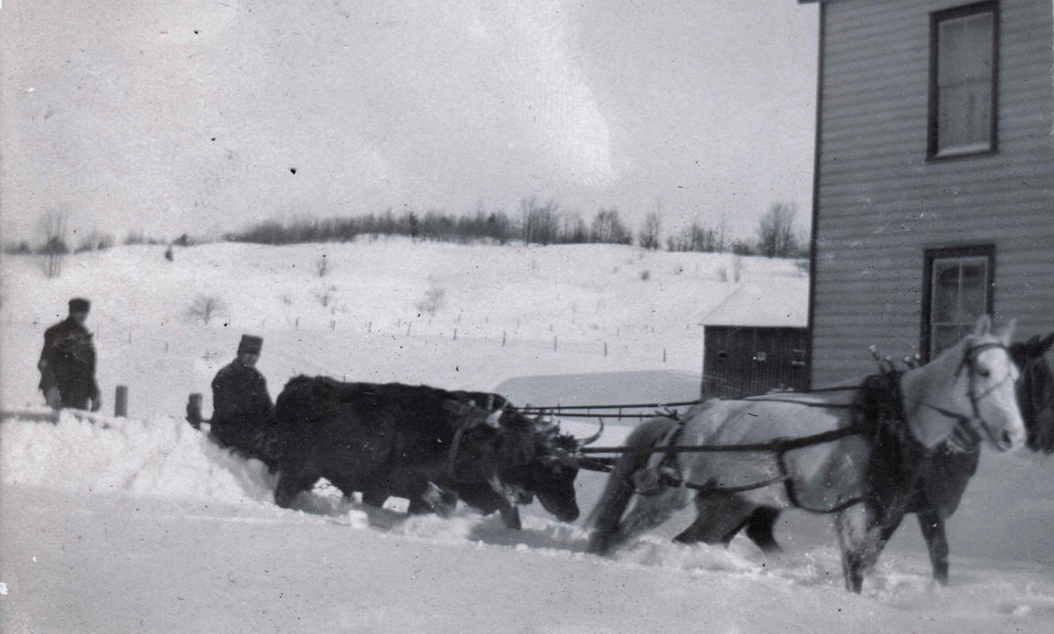
Data integration
North Country at Work https://tinyurl.com/4ecxaxbf

Slide 14
Data integration: iSDMs
A model that combines multiple presence-only, presence-absence, or count datasets—or any combination thereof—to relate species observations to environmental patterns

Slide 15
Observation Model 1
Presence-only data
4
Observation Model 2
2
1
0
Ecological state
1
0
Adapted from Isaac et al. (2020)
Count data

Slide 16
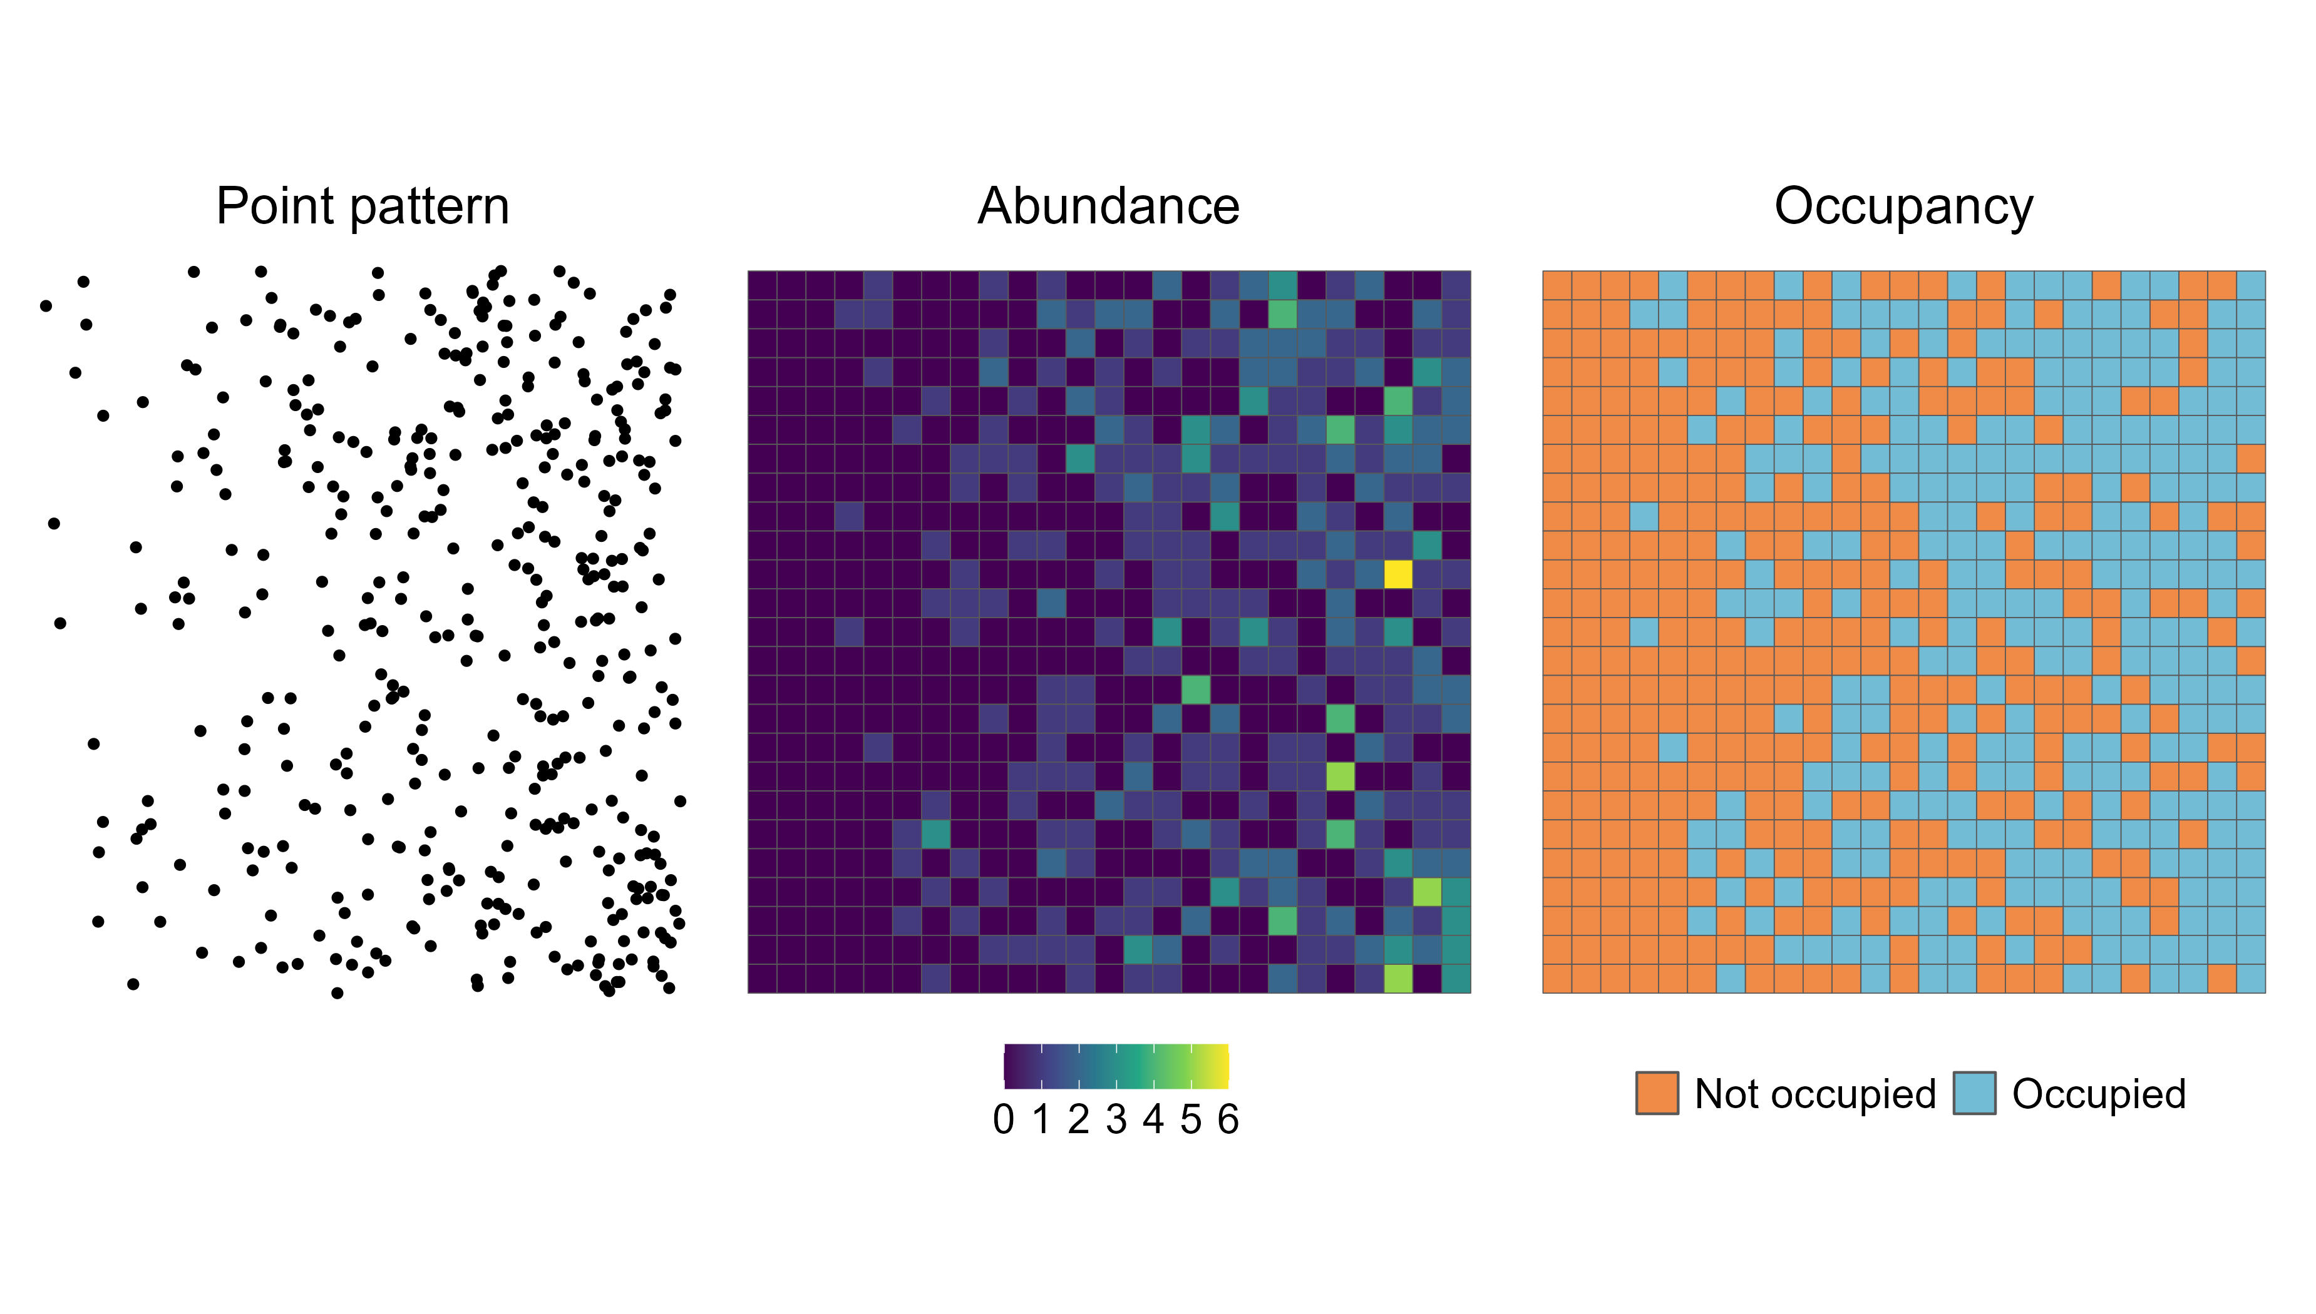

Slide 19
Suppose you have count and presence-absence data

Slide 20
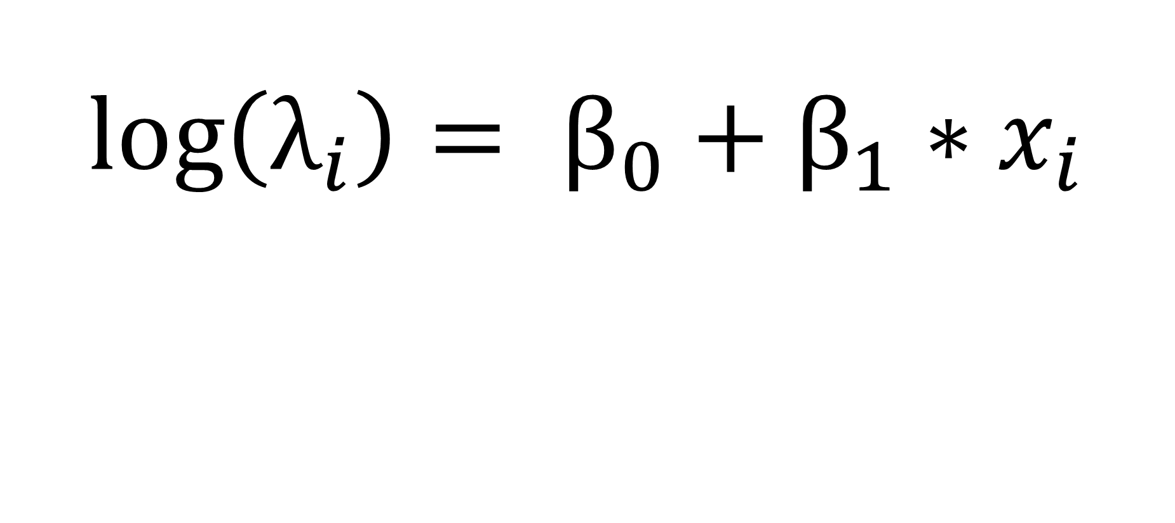
$$\log\left(λ_{i}\right)= β_{0}+β_{1}∗x_{i}$$
$N_{i} \sim Poisson(λ_{i}$)
$$C_{ij} \sim Binomial(N_{i}, p)$$

Slide 21
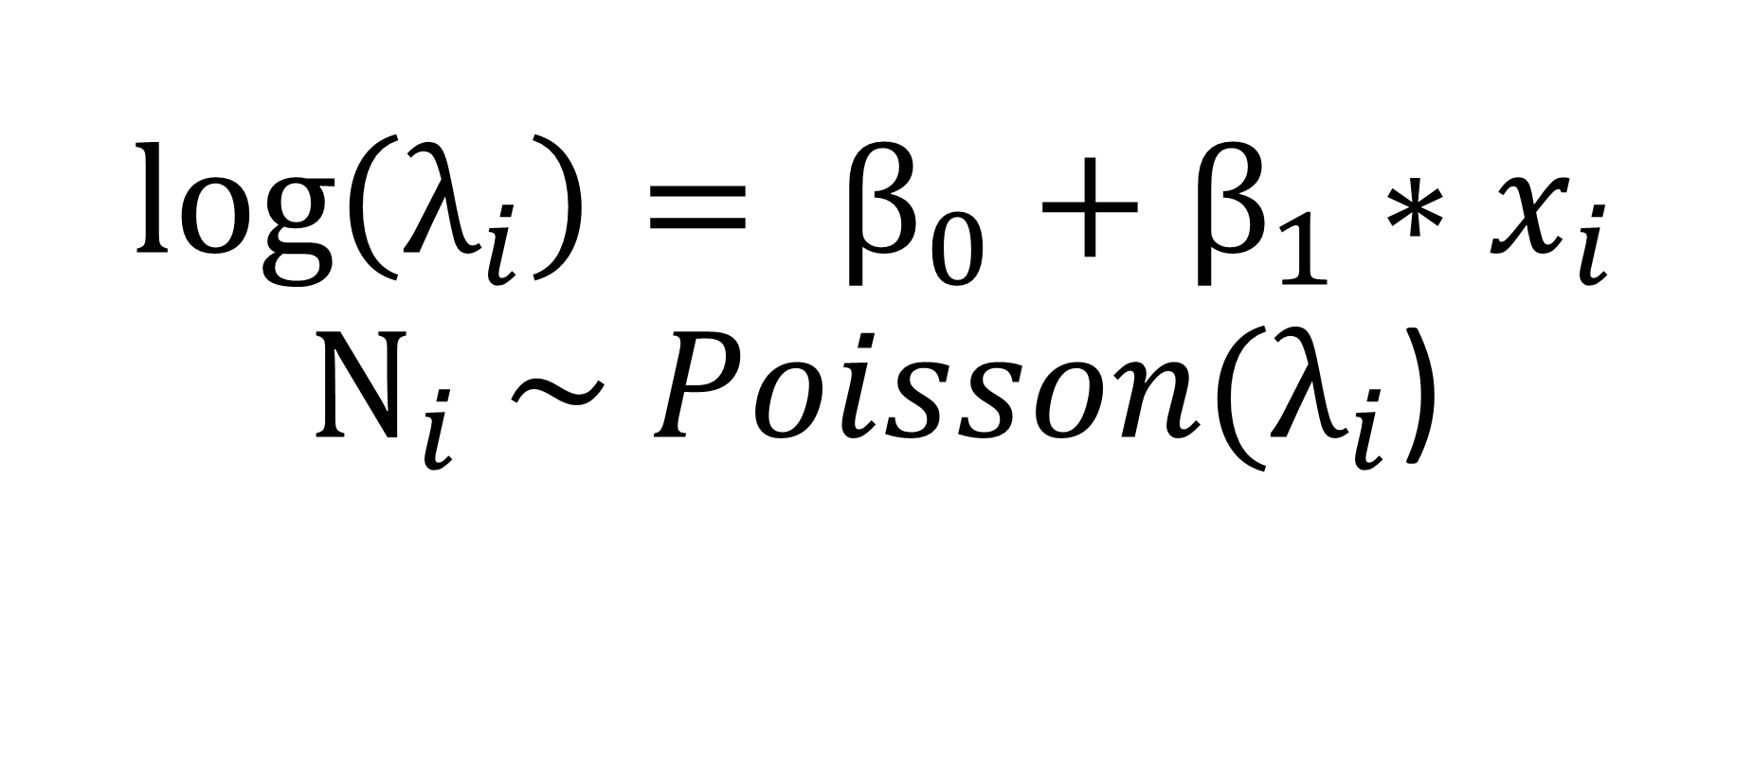
$$\log\left(λ_{i}\right)= β_{0}+β_{1}∗x_{i}$$
$N_{i} \sim Poisson(λ_{i}$)
$$C_{ij} \sim Binomial(N_{i}, p)$$

Slide 22
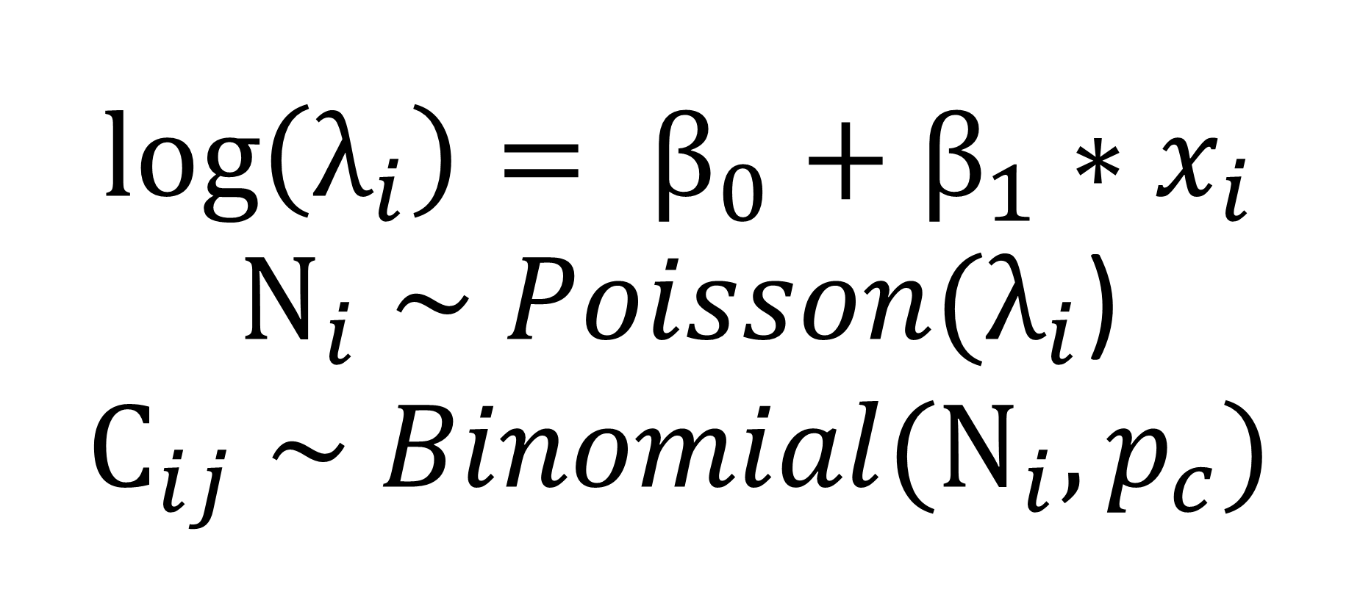
$$\log\left(λ_{i}\right)= β_{0}+β_{1}∗x_{i}$$
$N_{i} \sim Poisson(λ_{i}$)
$$C_{ij} \sim Binomial(N_{i}, p_{c})$$

Slide 23
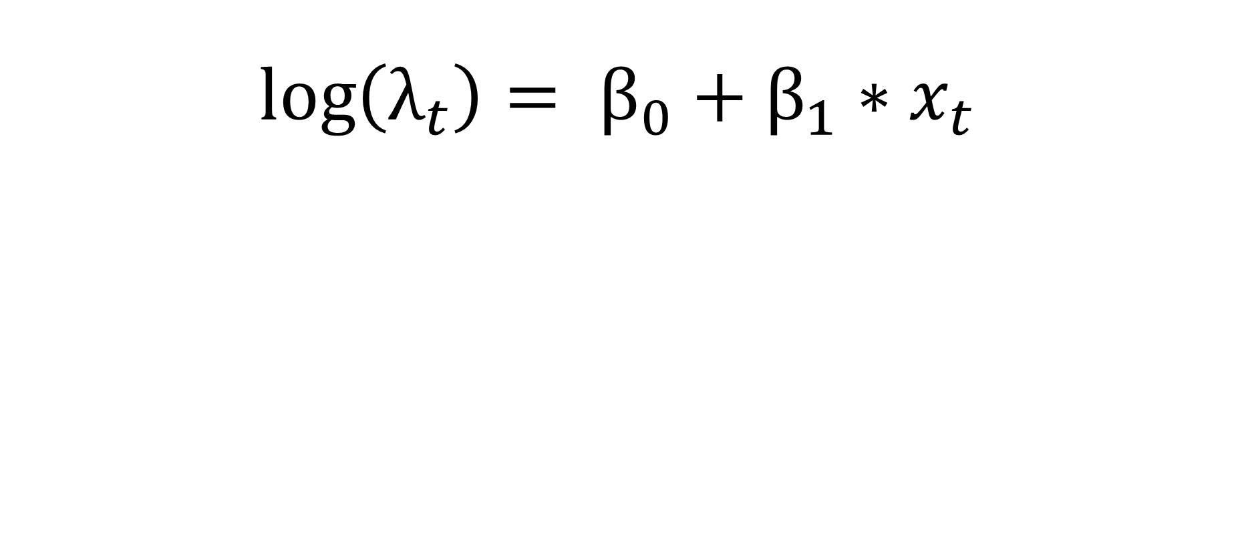
$$\log\left(λ_{t}\right)= β_{0}+β_{1}∗x_{t}$$
$z_{t} \sim Bernoulli( 1 −exp(−$ $λ_{t}))$
$$y_{tj}\sim Bernoulli(p_{d}∗z_{t})$$

Slide 24
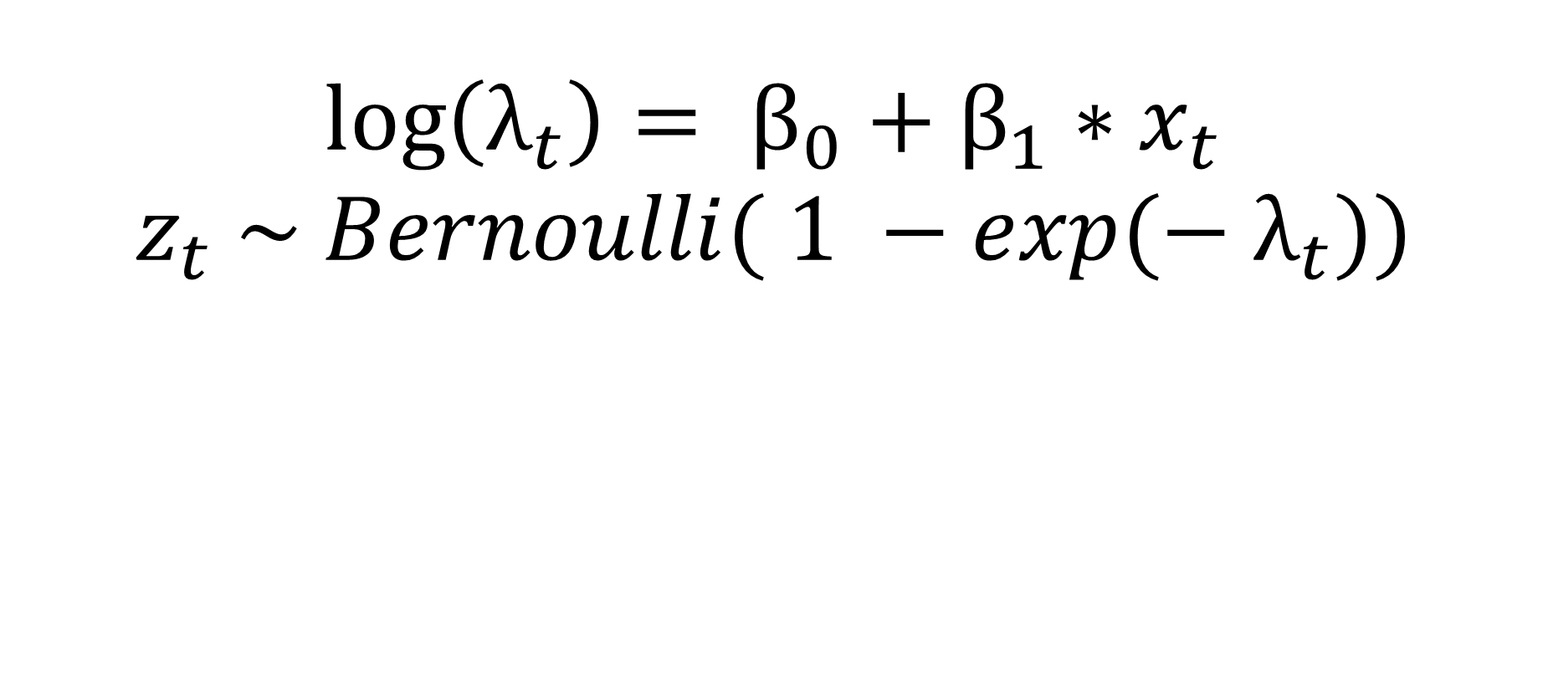
$$\log\left(λ_{t}\right)= β_{0}+β_{1}∗x_{t}$$
$z_{t} \sim Bernoulli( 1 −exp(−$ $λ_{t}))$
$$y_{tj}\sim Bernoulli(p_{d}∗z_{t})$$

Slide 25
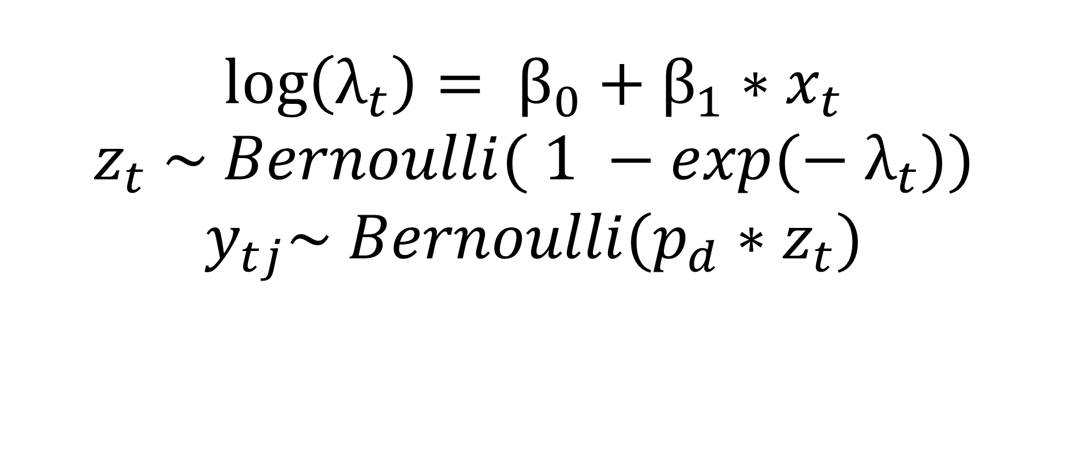
$$\log\left(λ_{t}\right)= β_{0}+β_{1}∗x_{t}$$
$z_{t} \sim Bernoulli( 1 −exp(−$ $λ_{t}))$
$$y_{tj}\sim Bernoulli(p_{d}∗z_{t})$$

Slide 26
Why use iSDMs?

Slide 27
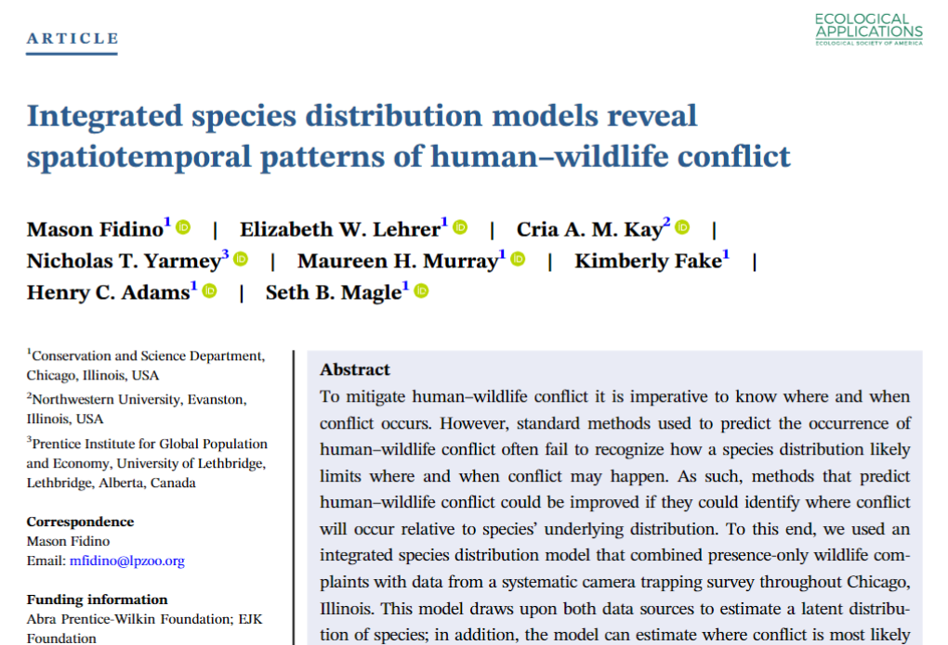
Get creative w/ distribution data

Slide 28
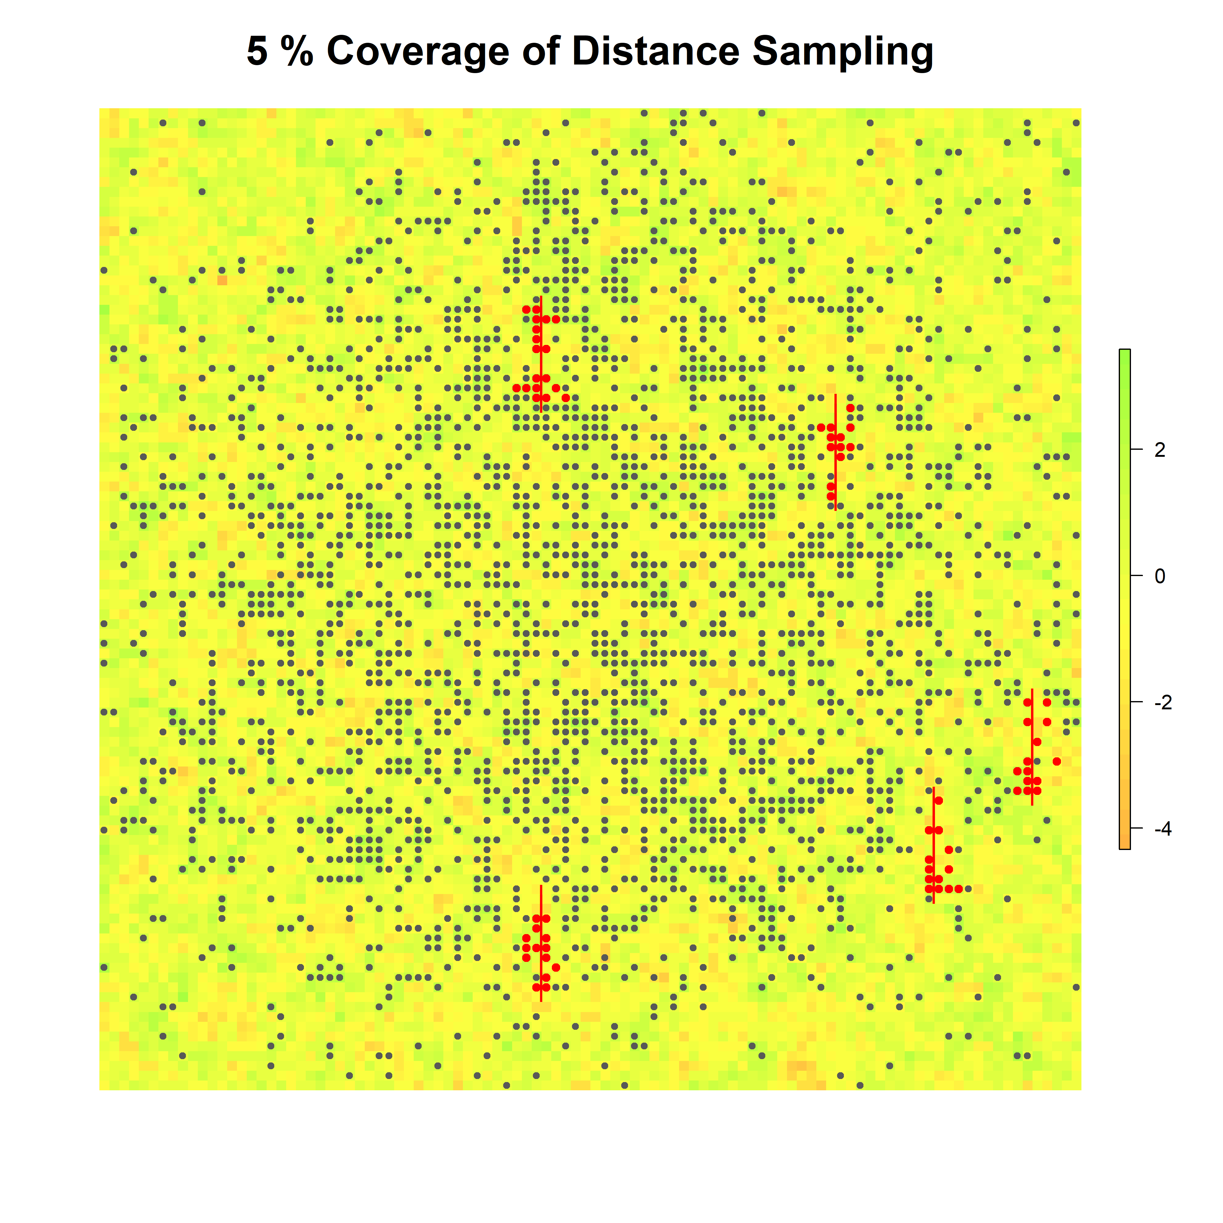
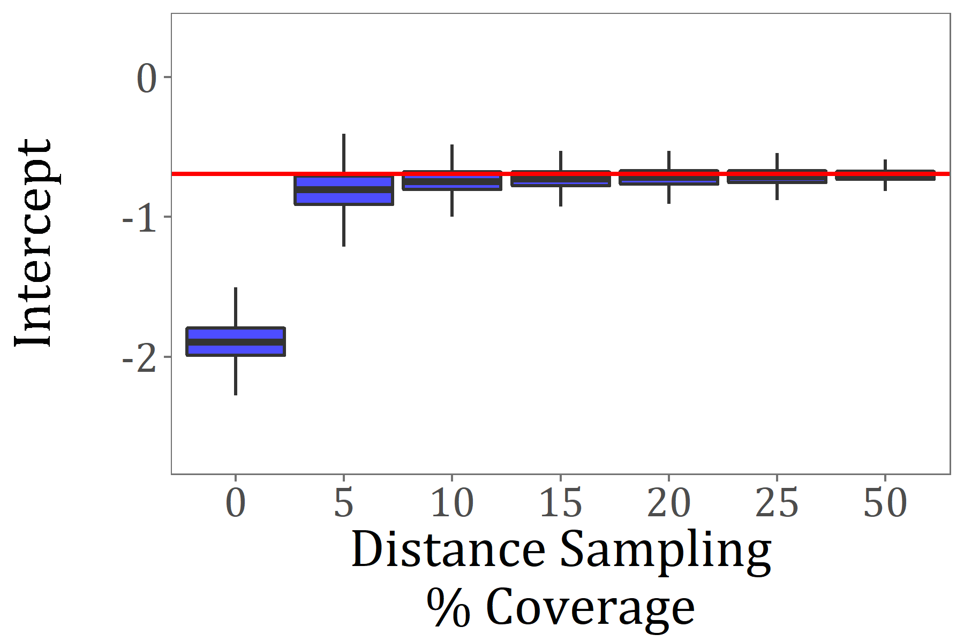
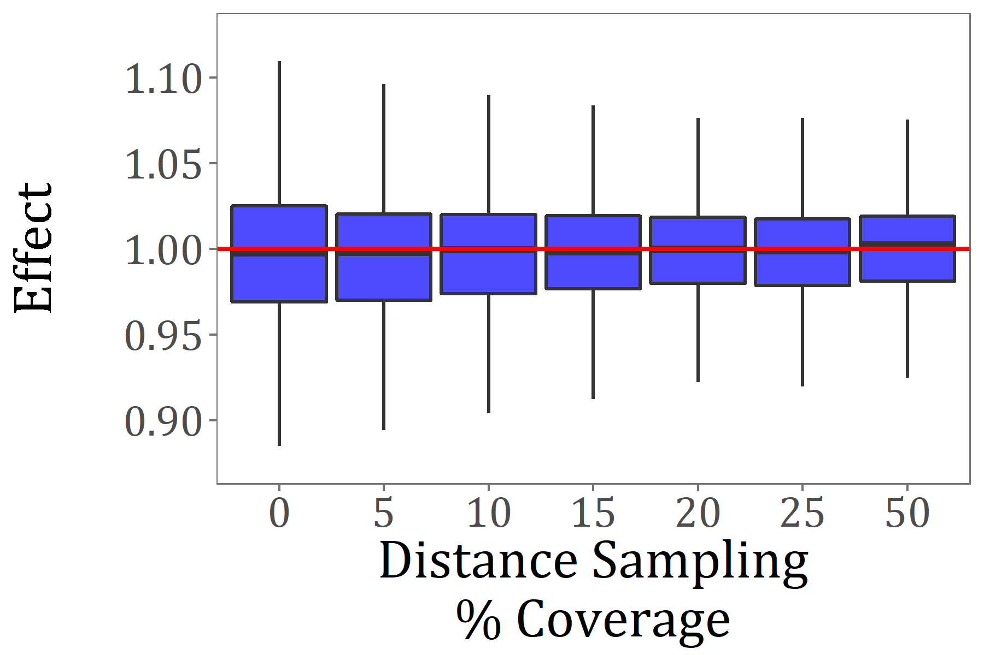
Increase accuracy & precision
Effect Abundance
Distance sampling data
% covered with distance sampling
Presence only data
Notes:
28

Slide 29
Expand inference
Presence-only data
1985
2023
Replicated counts
2023
2015
Notes:
29

Slide 30
Challenges & opportunities

Slide 31
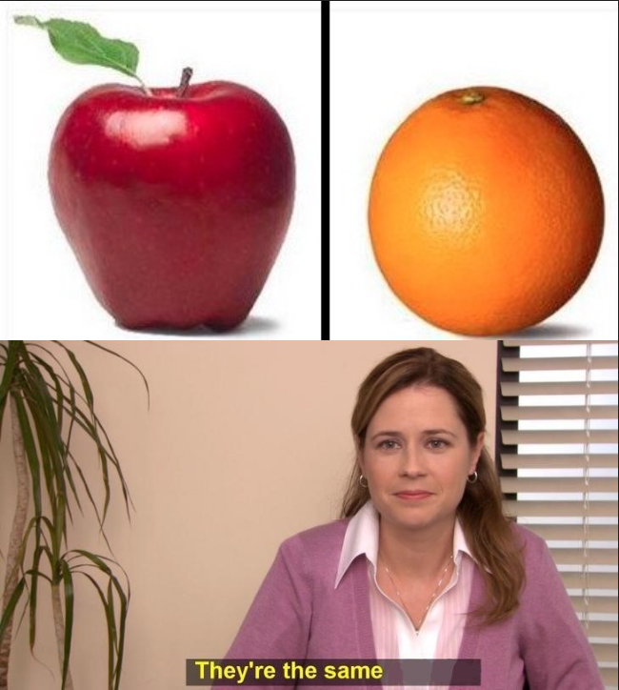
Are the shared parameters really the same?
They’re the same picture

Slide 32


Slide 33
Model selection, model validation…

Slide 34




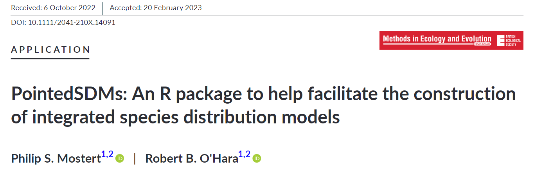
Buckle up, learn to code…
But some R packages coming online…

Slide 35
Speaking of coding…
https://r-nimble.org/html_manual/cha-installing-nimble.html
To use NIMBLE, you’ll need:
R
igraph, coda, and R6 R packages
A working C++ compiler (Rtools on Windows, Xcode on Mac)

Slide 36
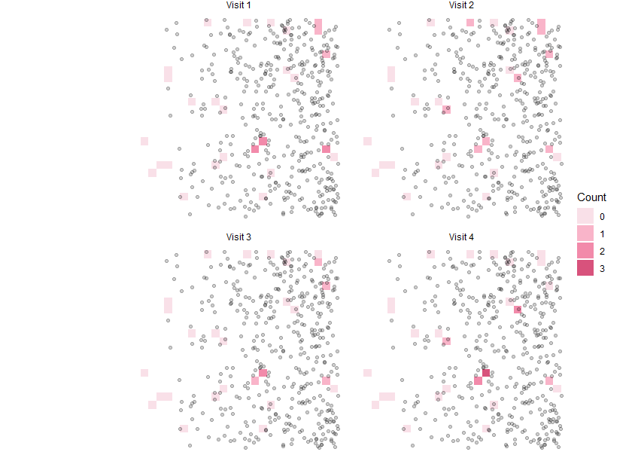
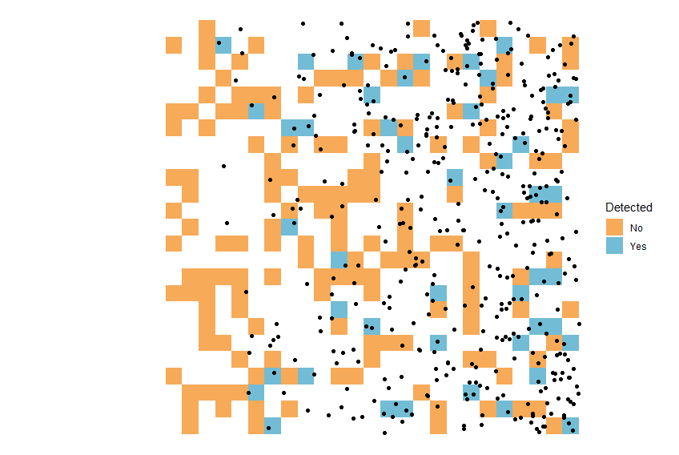
Example 1: Replicated counts + single-visit presence/absence data

Slide 37
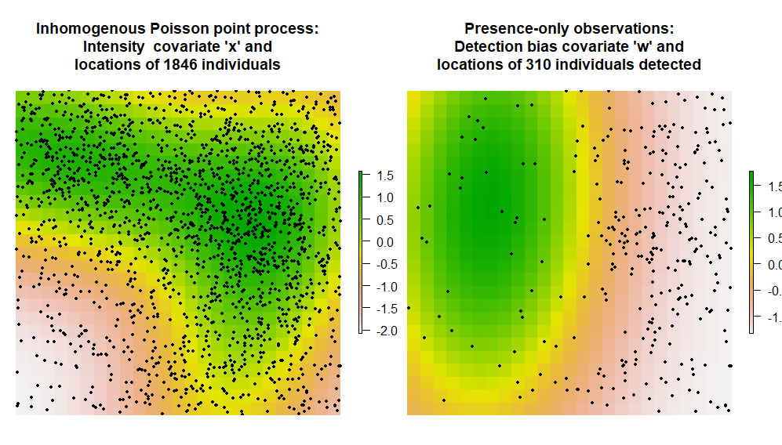
Example 2: presence-only data + replicated counts

Slide 38
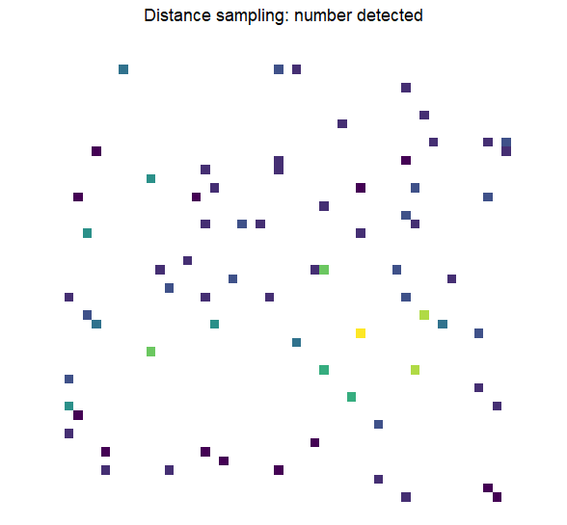
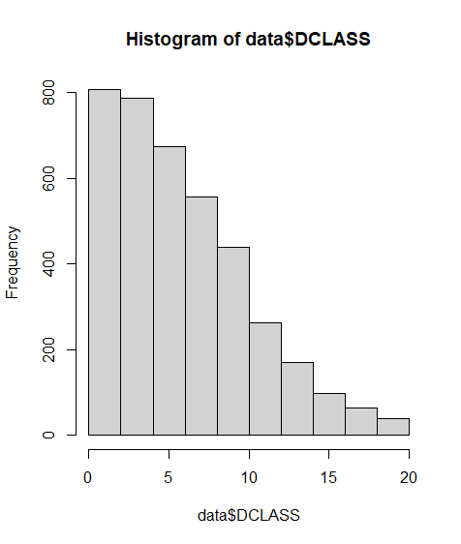
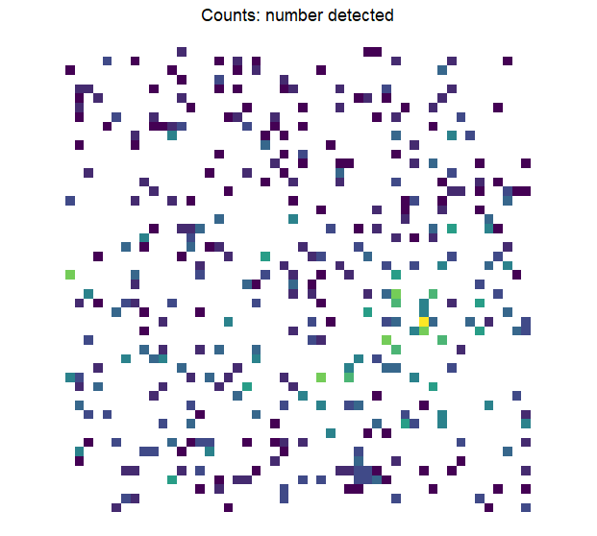
Example 3: single-visit counts + distance sampling data

Slide 39
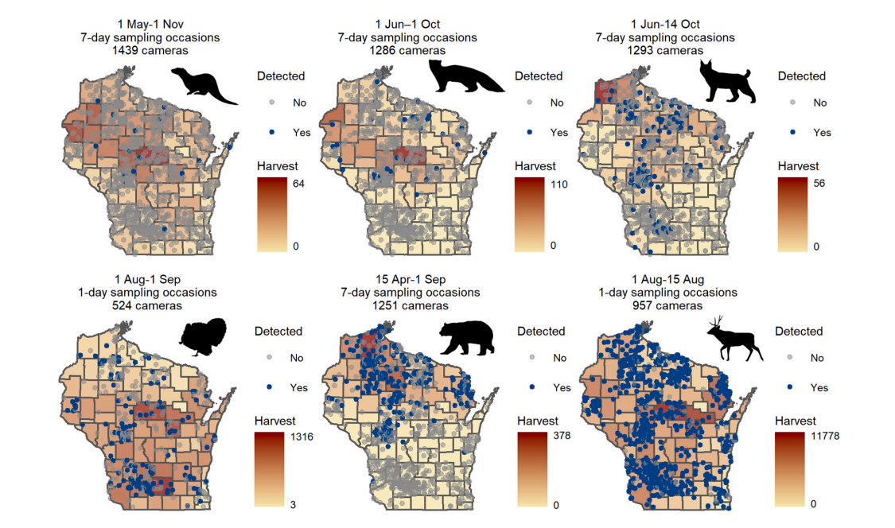
Example 4: Fine-res, replicated presence-absence data + coarse-res, single-visit counts

